Slide 1
How Double-Fetch Situations turn into Double-Fetch Vulnerabilities:
A Study of Double Fetches in the Linux Kernel
Pengfei Wang, National University of Defense Technology;
Jens Krinke, University College London;
Kai Lu and Gen Li, National University of Defense Technology;
Steve Dodier-Lazaro, University College London
26th USENIX Security Symposium,
August 16–18, 2017 • Vancouver, BC, Canada
J.T. ZHANG 2019.06, NUAA

Slide 2
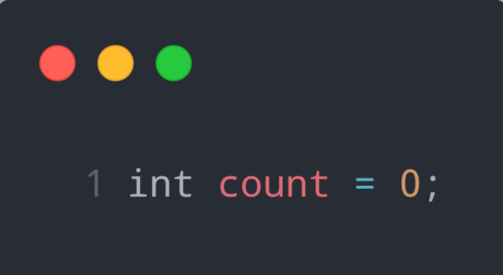
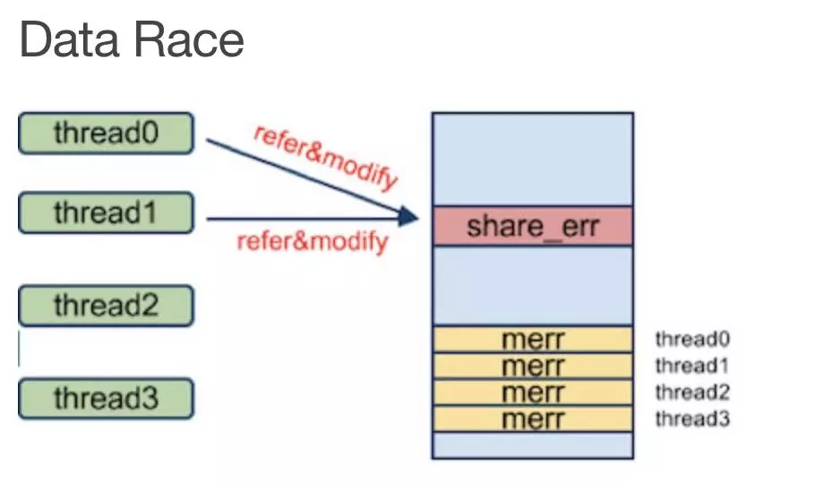
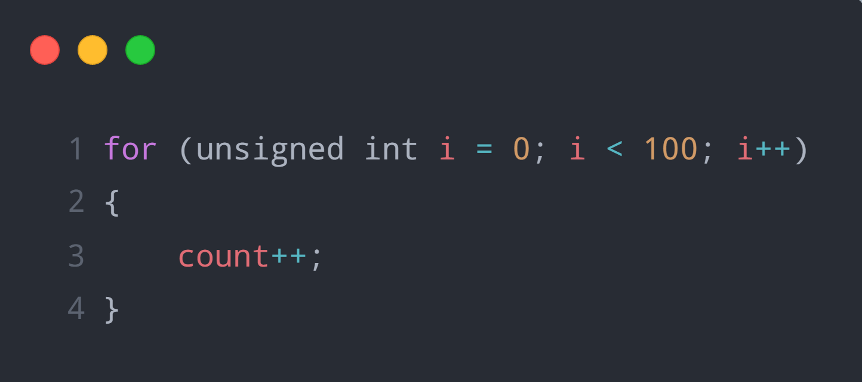

Multicore – Concurrent Programming
Data Race
Shared memory
At least one of the accesses is a write
Atomicity-violation
Notes:
执行结果取决于线程执行的顺序

Slide 3
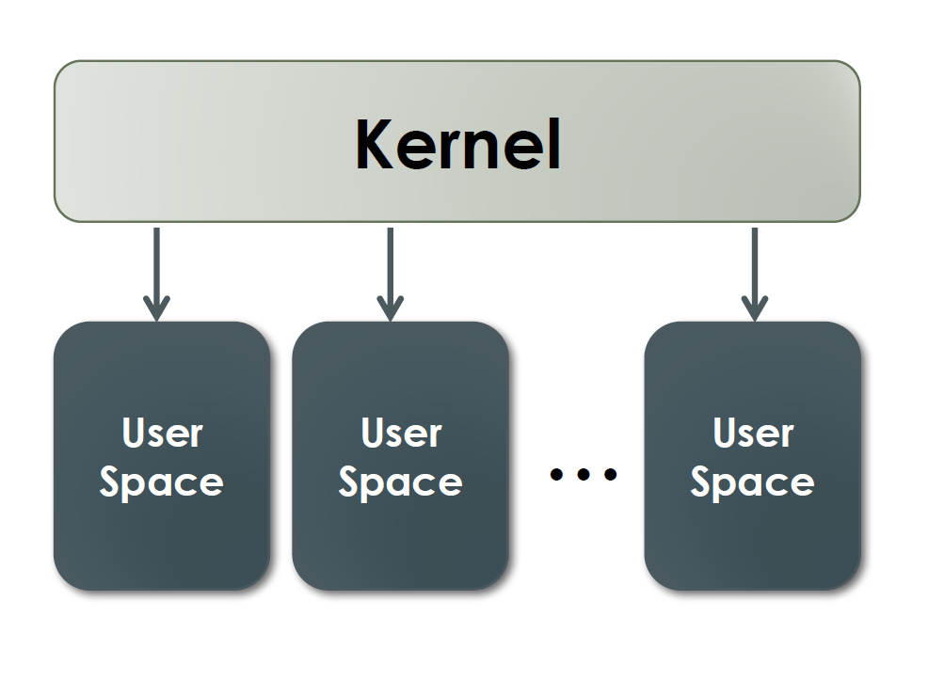
Kernel/User Space Protection
Kernel space
User space
Each user process has its own virtual memory space
User space is isolated - Virtual address → Physical address
Only the kernel can access all user spaces

Slide 4
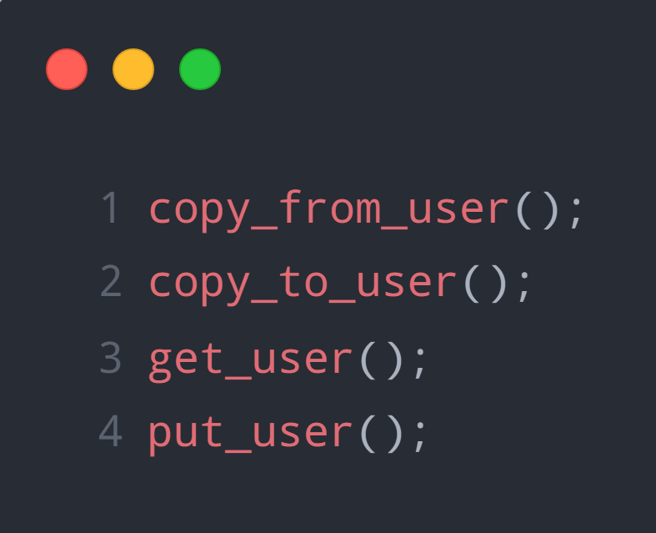
Kernel/User Space Data Exchange
Transfer Functions

Slide 5


Memory Access in Drivers
Kernel components
Bridge between software & hardware
In Linux : Device → File
File I/O system call
Copy data from kernel to user space –
Copy data from user space to kernel –

Slide 6
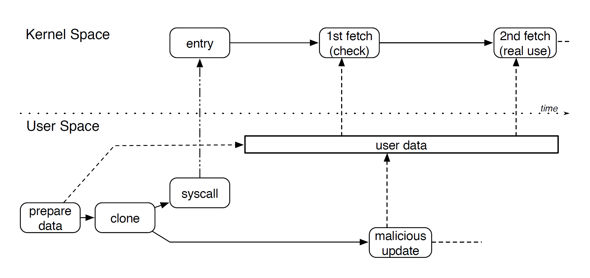
What is Double-Fetch?
Kernel fetch data from the same memory location twice
During two fetch, the memory is modified

Slide 7
Double-Fetch Grade
Benign double fetch
Protection schemes
Double-fetched value is not used
Harmful double fetch
Could cause failures under specific conditions
Double-fetch vulnerability
Privilege escalation
Information leakage
Kernel crash

Slide 8
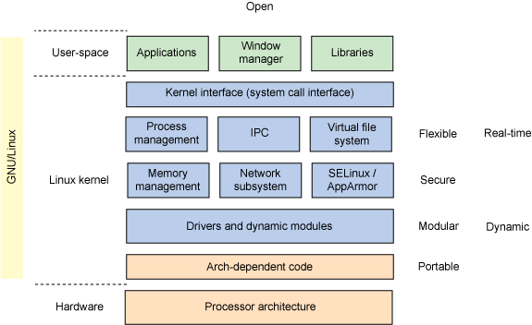
Related Works
Dynamic Analysis
Devices?
Architectures?
Overhead?
Static Analysis
Source code
Missing context – false reports

Slide 9
Pattern-based static analysis
Basic Pattern Matching Analysis
Identify multiple invocations of transfer function
Analyze manually & categorize
Refined Double-Fetch Bug Detection
Find double-fetch vulnerabilities

Slide 10
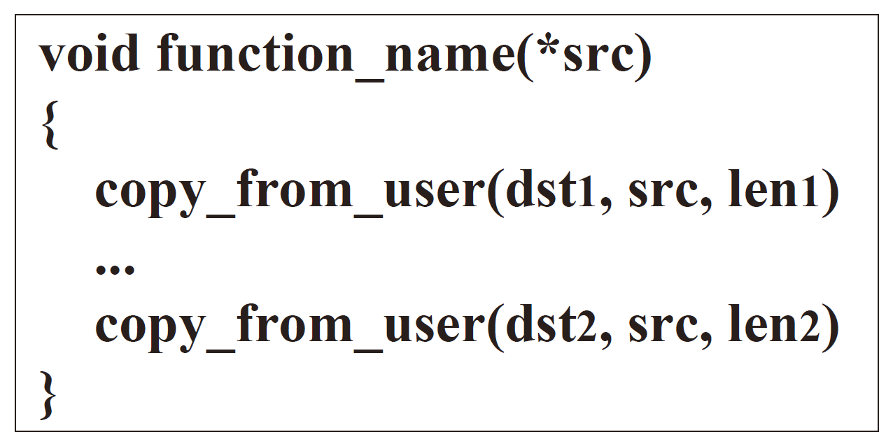
Basic Pattern Matching Analysis
Basic Pattern: In one function, fetching data from user space more than twice
Matching all get_user() or copy_from_user() variants
Target address and copy size can be different
Source address must be the same

Slide 11
Basic Pattern Matching Analysis
False Positives
Fetching different element of the same structure
Adding offset
Automatically removed

Slide 12
Double Fetch Categorization
Size checking
Type selection
Shallow copy

Slide 13
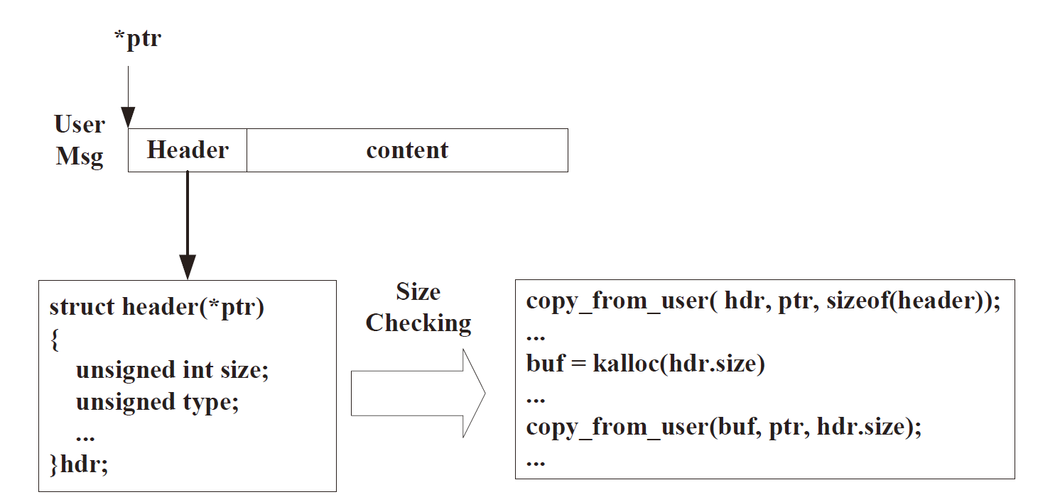
Double Fetch Categorization – Size Checking
Message Data
Header
Body (vary in length)
First fetch
Header only
Get message size, check validity, allocate buffer
Second fetch
Complete message copied to local buffer

Slide 14
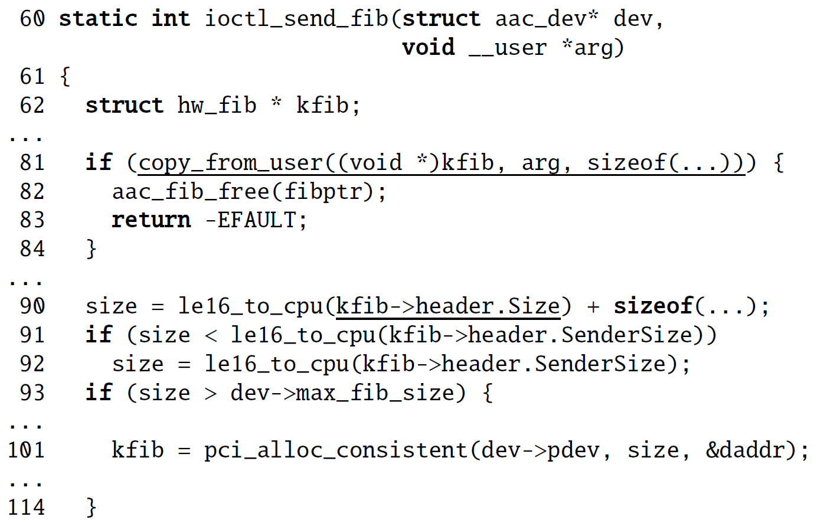
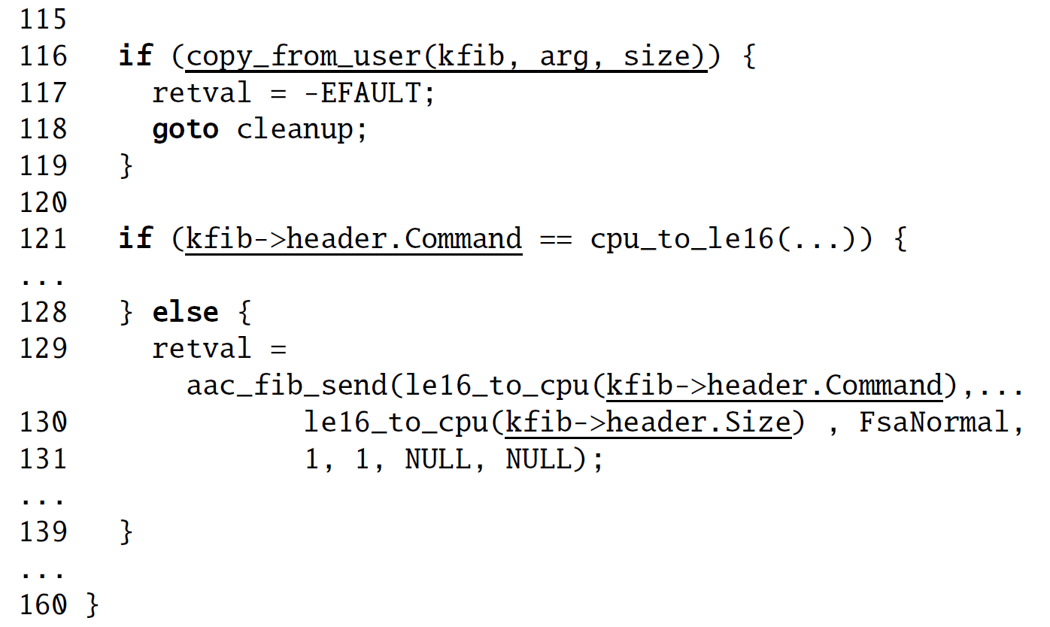
Double Fetch Categorization – Size Checking
Adaptec RAID controller driver - commctrl.c (CVE-2016-6480)

Slide 15
Double Fetch Categorization – Size Checking
Results
30 occurrences
22 in drivers
4 of 22 in drivers occurrences cause double-fetch bugs

Slide 16
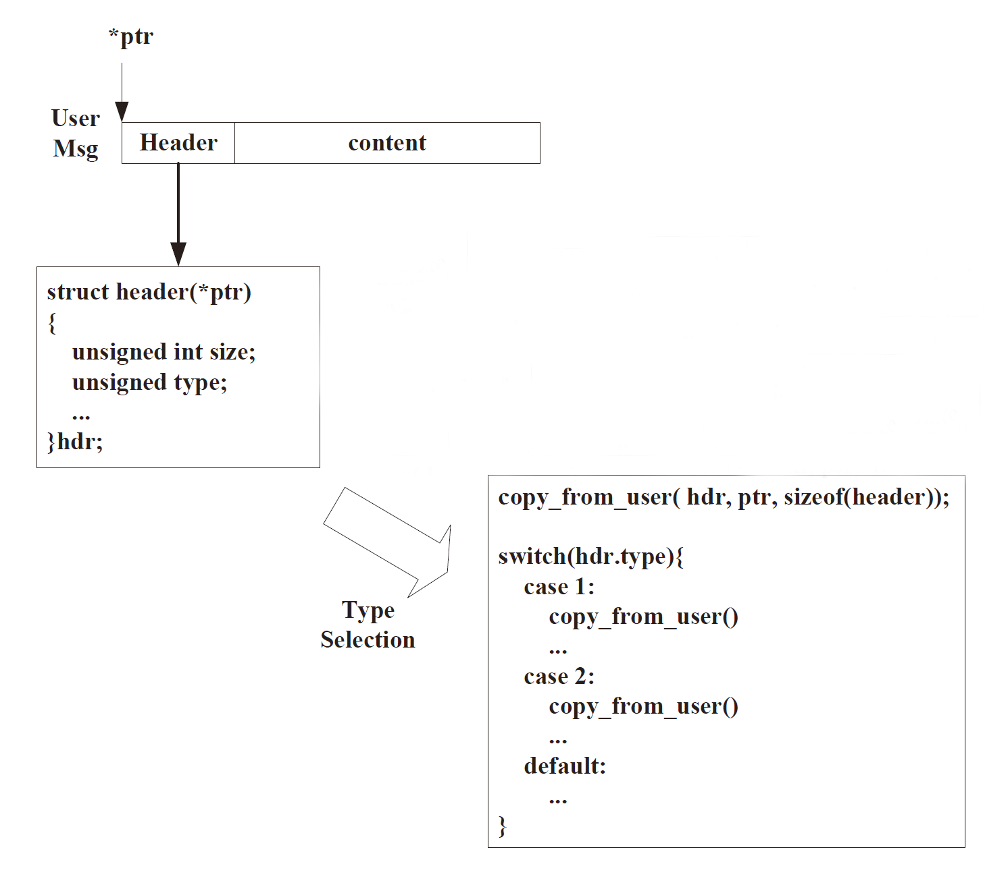
Double Fetch Categorization – Type Selection
Message Data
Header
Body
First fetch
Header only
Recognize message type
Second fetch
Complete message copied to local buffer

Slide 17
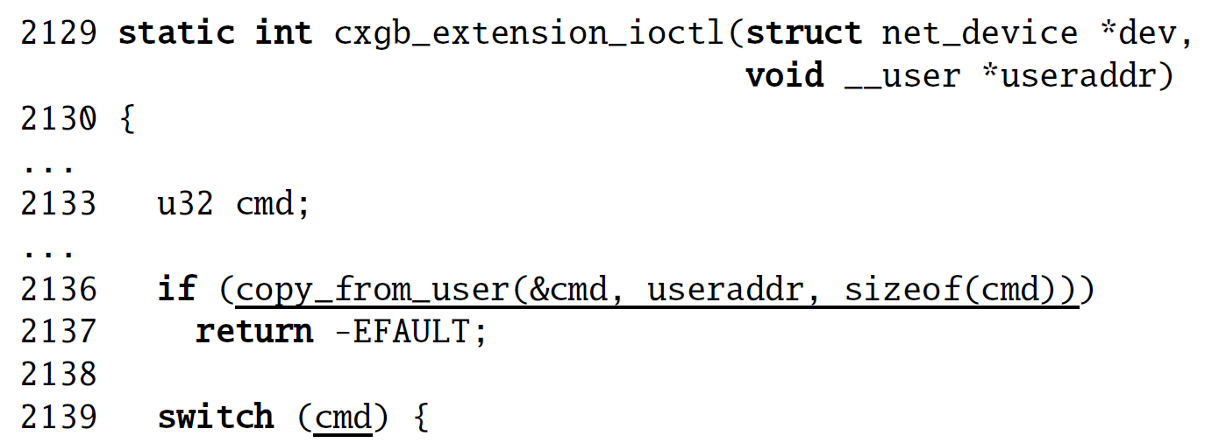
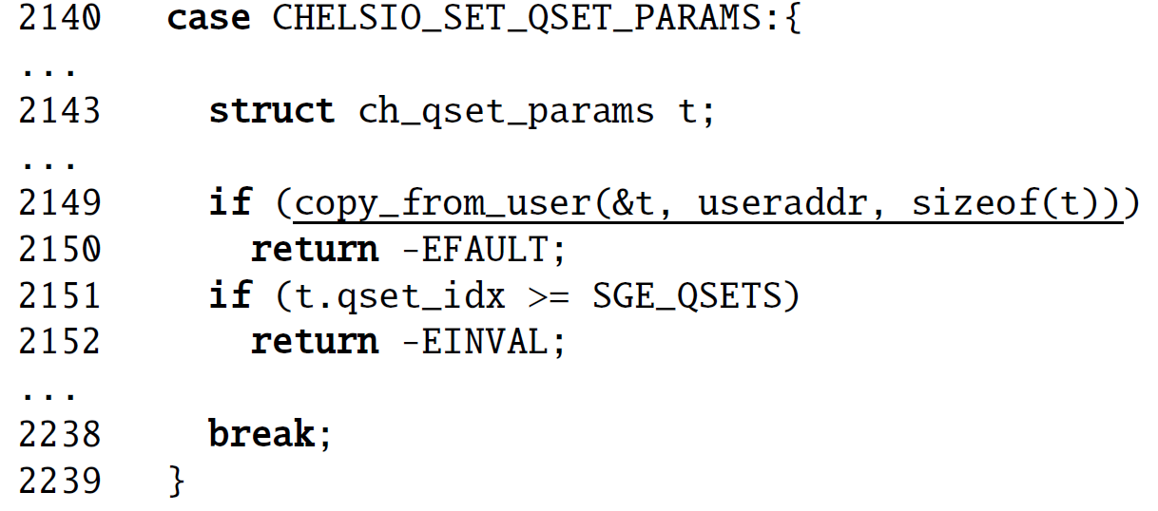
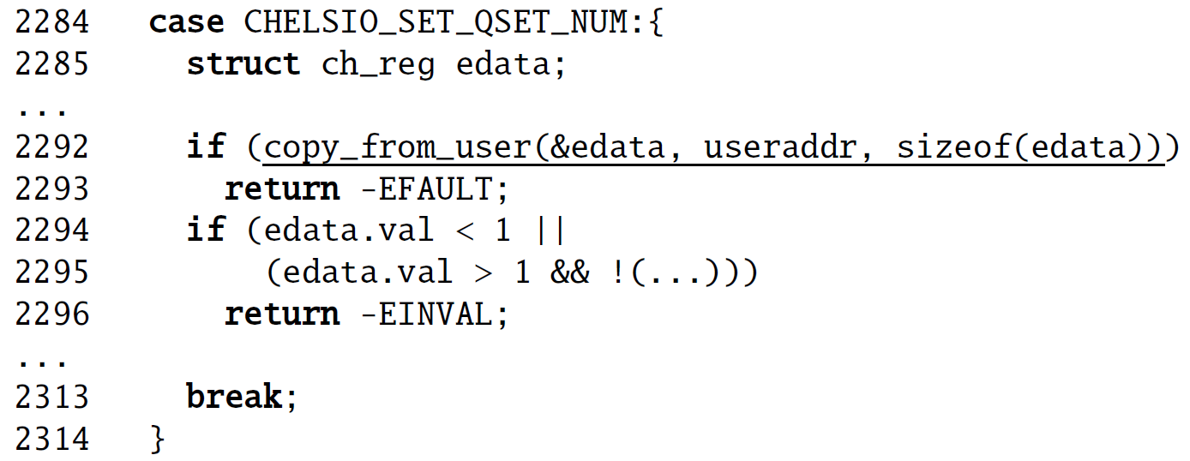
Double Fetch Categorization – Type Selection
Network driver - xgb3_main.c
No vulnerability

Slide 18
Double Fetch Categorization – Type Selection
Results
11 occurrences
9 in drivers
None of 11 occurrences cause double-fetch bugs

Slide 19
Double Fetch Categorization – Shallow Copy
buffer2
Copy buffer1 → Shallow copy
Copy buffer2 → Deep copy
buffer1
Results
31 occurrences
19 in drivers

Slide 20
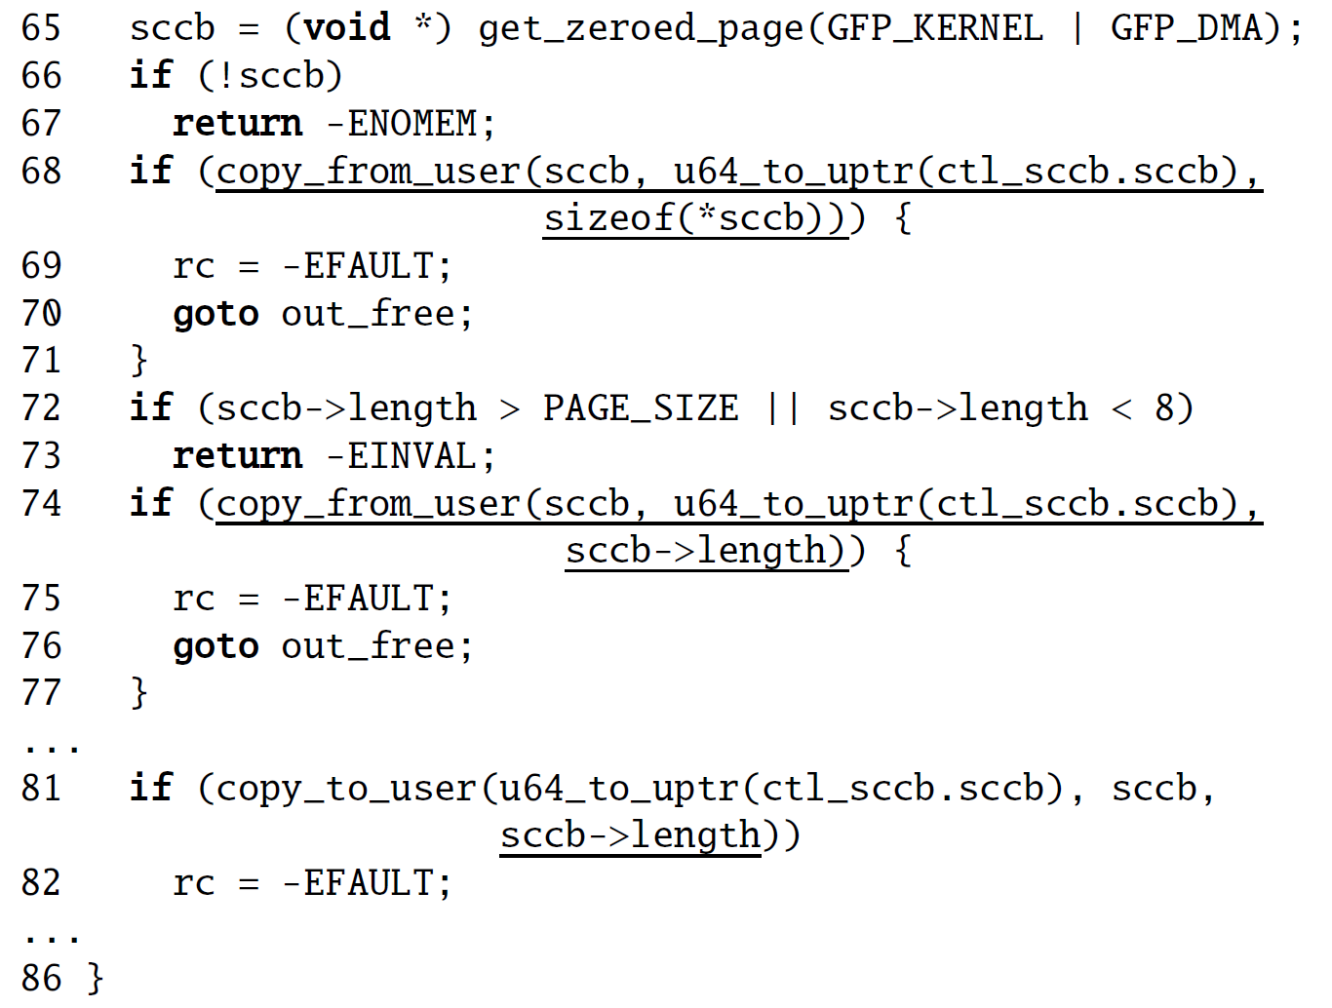
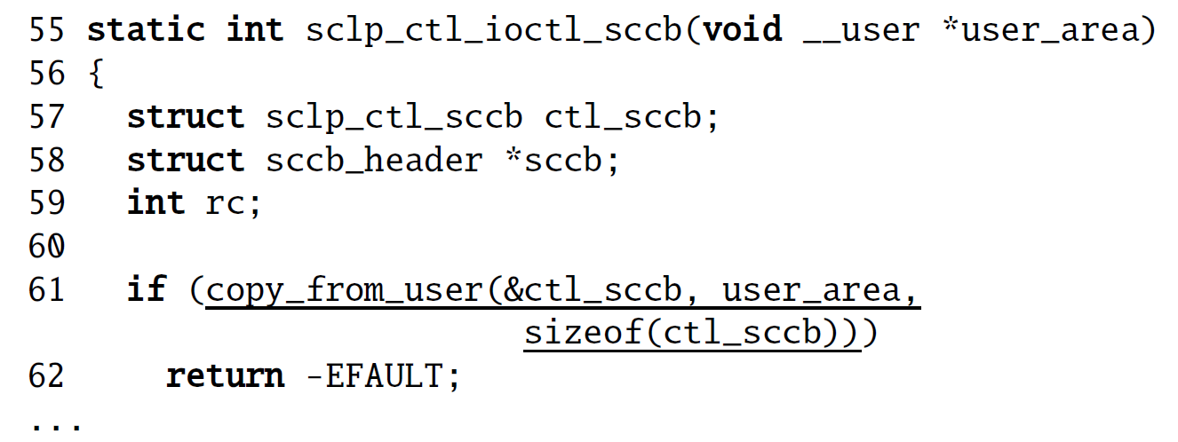
Double Fetch Categorization – Shallow Copy
IBM S/390 SCLP console driver - sclp_ctl.c (CVE-2016-6130)

Slide 21
Refined Double-Fetch Bug Detection
Improved analysis
Specifically identify double-fetch bugs
Rule 0 (basic rule) – two reads fetch data from the same location
More rules…
Coccinelle applied these rules one by one

Slide 22
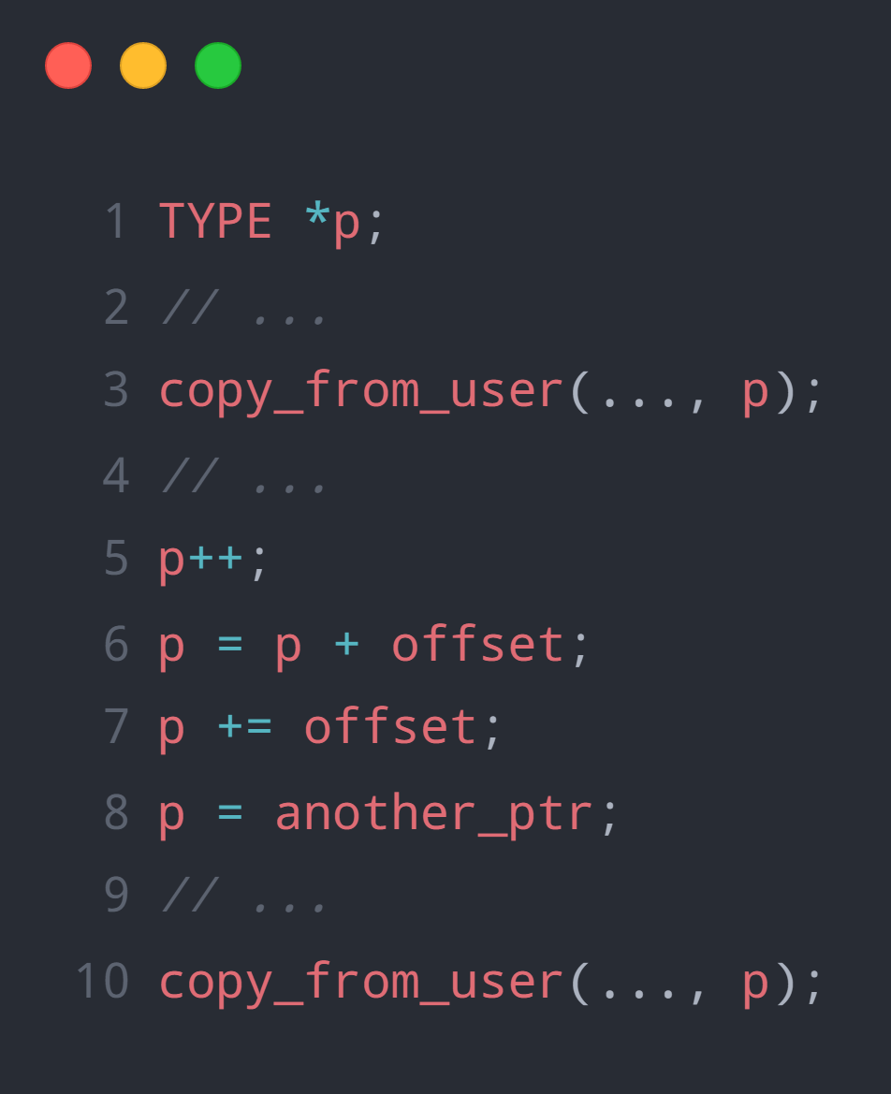
Refined Double-Fetch Bug Detection
Rule 1 – No pointer change
Keeping the user pointer unchanged between two fetches
Self-increment (++/--)
Adding an offset
Assignment of another value
False positives

Slide 23
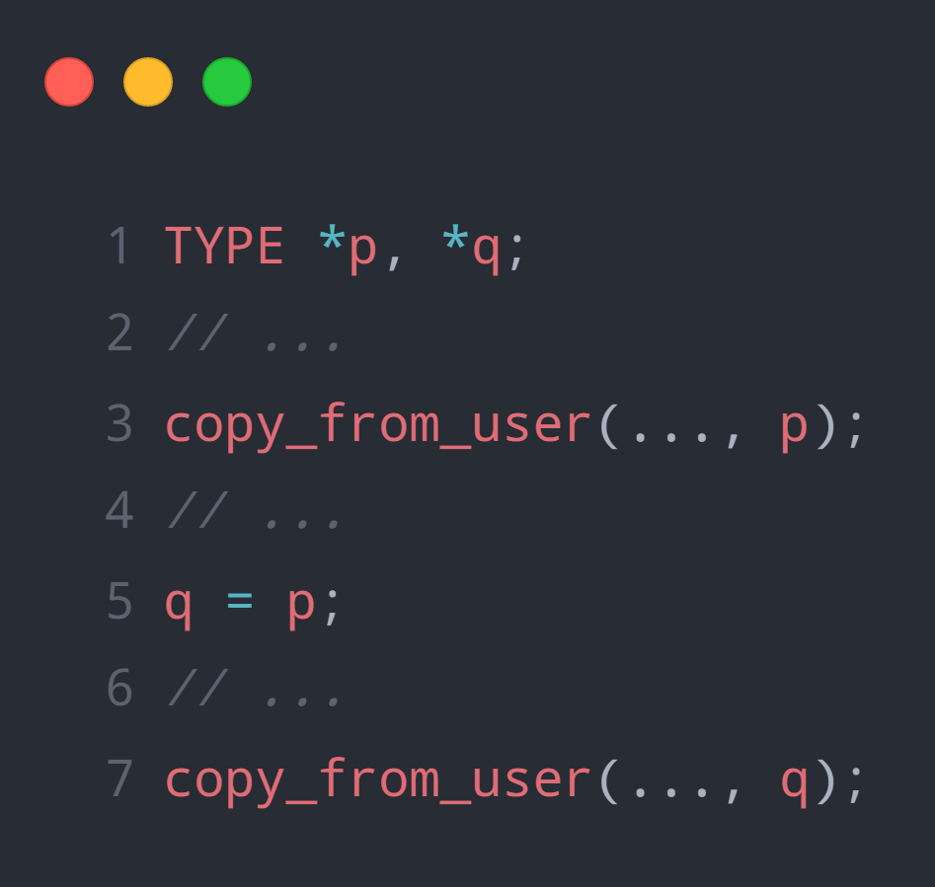
Refined Double-Fetch Bug Detection
Rule 2 – Pointer Aliasing
Source pointer is assigned to another pointer
For convenience
False negatives

Slide 24
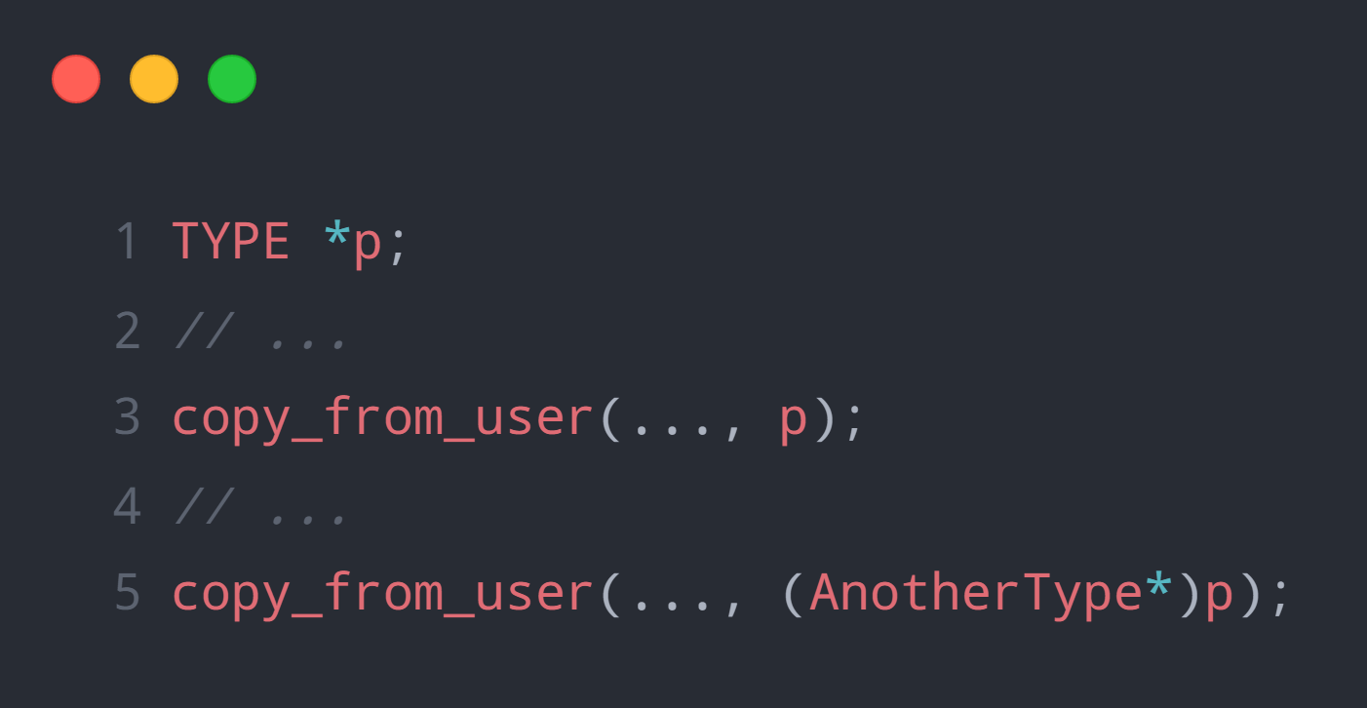
Refined Double-Fetch Bug Detection
Rule 3 – Explicit type conversion
Causing the same memory region to be manipulated by two types of pointers
First fetch – (header pointer)
Second fetch – message pointer
False negatives

Slide 25
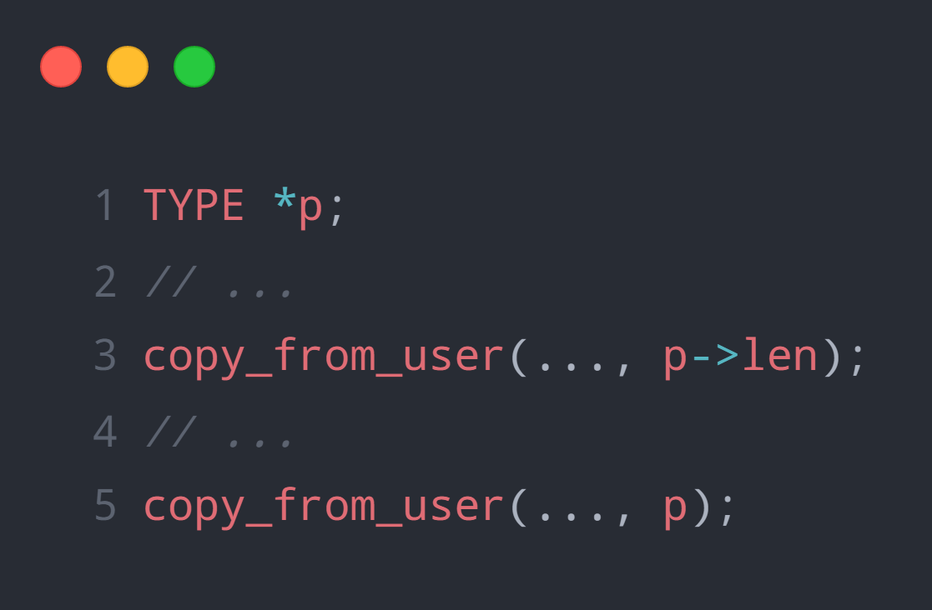
Refined Double-Fetch Bug Detection
Rule 4 – Combination of element fetch and pointer fetch
Pointer is both used to fetch the whole data structure as well as only a part
Not using the same pointer
But cover the same value
False negatives

Slide 26
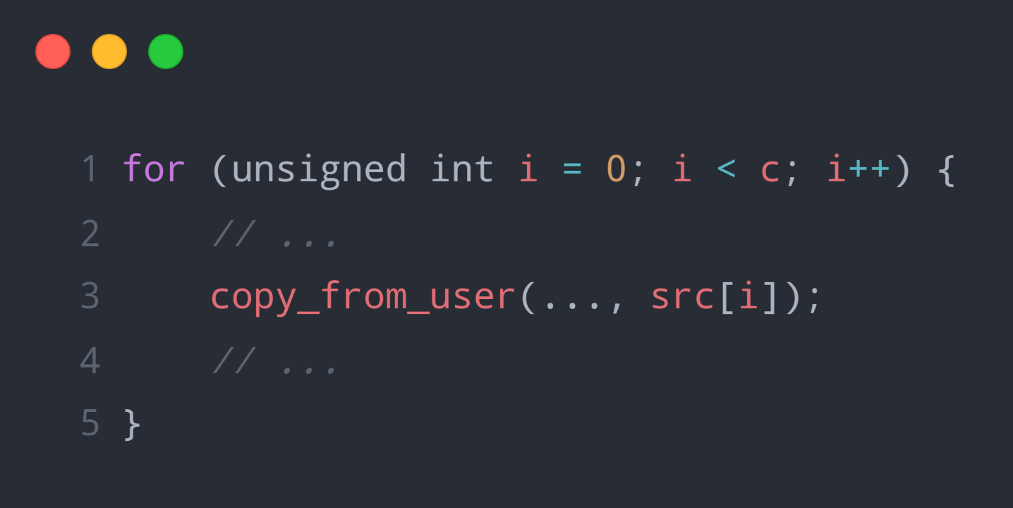
Refined Double-Fetch Bug Detection
Rule 5 – Loop involvement
One transfer function call in a loop will be reported as two calls
Should be removed
Cross-iteration transfer function call
False positives

Slide 27

Tool - Coccinelle
An open-source utility for matching and transforming the source code of programs written in the C programming language using a "semantic patch" syntax based on the patch syntax.
Semantic Patch Language (SmPL)

Slide 28
Evaluation
Linux 4.5
Android 6.0.1 (based on Linux 3.18)
FreeBSD (master branch)
Drivers are the hard-hit area
Benign case could turn into a vulnerability with code update (CVE-2016-5728)

Slide 29
Double-Fetch BUG Prevention
Don’t copy the header twice (only copy body in the second fetch)
Use the same value
Only use the data from one of the fetches
Overwrite data
Overwrite the header with the first fetch (widely adopted in FreeBSD)
Compare data
Compare before using, abort the operation if the data is not the same
Synchronize fetches
Guarantee the atomicity
Performance penalties

Slide 30
Limitations
Preprocessed code
Compiled code
Double-fetch can occur in:
Macros
Compiler optimization (in compiled binary, not in source code)
Not labeled as volatile
Turn the memory access from single to multiple at the binary level

Slide 31
Thanks.
Q&A ?

